Slide 1
Living in a cracked creation
The Power and the Promise of Evil, Suffering, and Sin

Slide 2
Creation (our World) is Cracked. Why? Genesis 1 calls God’s creation “Good” genesis 3 introduces sin and “the fall”

Slide 3
THORNY THEOLOGICAL QUESTIONS
WHY DOES EVIL EXIST?
WHO IS RESPONSIBLE FOR EVIL, SIN, AND SUFFERING?
WHY DOES GOD ALLOW EVIL, SIN, AND SUFFERING TO EXIST?

Slide 4
https://www.stevethomason.net/2015/08/14/terence-fretheim-on-suffering-sin-and-evil/
THINK ABOUT . . .
WHAT IS NEW TO YOU IN THE PRESENTATION?
WHAT DO YOU FIND ESPECIALLY HELPFUL?
WHAT ADDITIONAL QUESTIONS ARE RAISED FOR YOU?

Slide 5
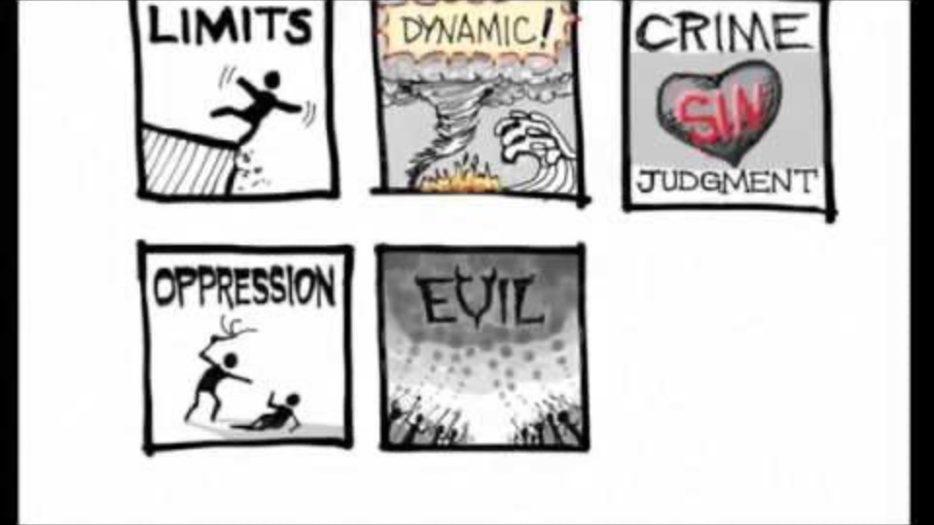
https://www.stevethomason.net/2015/08/14/terence-fretheim-on-suffering-sin-and-evil/
THINK ABOUT . . .
WHAT IS NEW TO YOU IN THE PRESENTATION?
WHAT DO YOU FIND ESPECIALLY HELPFUL?
WHAT ADDITIONAL QUESTIONS ARE RAISED FOR YOU?

Slide 6
WHAT IS NEW TO YOU IN THE PRESENTATION? WHAT DO YOU FIND ESPECIALLY HELPFUL? WHAT ADDITIONAL QUESTIONS ARE RAISED FOR YOU?

Slide 7
SOURCES OF SUFFERING
LIMITS
DYNAMIC
SIN [REQUIRES JUDGMENT]
OPPRESSION / INJUSTICE
SYSTEMIC EVIL
CALLING

Slide 8
TREE OF LIFE VS. TREE OF KNOWING GOOD AND EVIL
https://www.youtube.com/watch?v=TJLan-pJzfQ
THINK ABOUT . . .
WHAT IS NEW TO YOU IN THE PRESENTATION?
WHAT DO YOU FIND ESPECIALLY HELPFUL?
WHAT ADDITIONAL QUESTIONS ARE RAISED FOR YOU?

Slide 9
TREE OF LIFE VS. TREE OF KNOWING GOOD AND EVIL
https://www.youtube.com/watch?v=TJLan-pJzfQ
THINK ABOUT . . .
WHAT IS NEW TO YOU IN THE PRESENTATION?
WHAT DO YOU FIND ESPECIALLY HELPFUL?
WHAT ADDITIONAL QUESTIONS ARE RAISED FOR YOU?

Slide 10
WHAT IS NEW TO YOU IN THE PRESENTATION? WHAT DO YOU FIND ESPECIALLY HELPFUL? WHAT ADDITIONAL QUESTIONS ARE RAISED FOR YOU?

Slide 11
EATING FROM THE TREE OF KNOWLEDGE OF GOOD AND BAD LED TO BROKEN RELATIONSHIP
Burning Bush (Exodus 3) and Sinai/Ten Commandments (Exodus 20)
PSALM 1:1-3
Happy are those who do not follow the advice of the wicked, or take the path that sinners tread, or sit in the seat of scoffers; but their delight is in the law of the Lord, and on his law they meditate day and night. They are like trees planted by streams of water, which yield their fruit in its season, and their leaves do not wither. In all that they do, they prosper.

Slide 12
JESUS IS THE TREE OF LIFE
HE WAS CUT DOWN AND WENT THROUGH DEATH TO NEW LIFE
THOSE WHO EAT OF THIS NEW TREE GO THROUGH DEATH TO NEW LIFE
ROMANS 6:1-11

Slide 13
6What then are we to say? Should we continue in sin in order that grace may abound? ²By no means! How can we who died to sin go on living in it? ³Do you not know that all of us who have been baptized into Christ Jesus were baptized into his death? ⁴Therefore we have been buried with him by baptism into death, so that, just as Christ was raised from the dead by the glory of the Father, so we too might walk in newness of life.
5 For if we have been united with him in a death like his, we will certainly be united with him in a resurrection like his. ⁶We know that our old self was crucified with him so that the body of sin might be destroyed, and we might no longer be enslaved to sin. ⁷For whoever has died is freed from sin. ⁸But if we have died with Christ, we believe that we will also live with him. ⁹We know that Christ, being raised from the dead, will never die again; death no longer has dominion over him. ¹⁰The death he died, he died to sin, once for all; but the life he lives, he lives to God. ¹¹So you also must consider yourselves dead to sin and alive to God in Christ Jesus.

Slide 14
FINAL THOUGHTS?
LOOKING AHEAD . . . .
SEPTEMBER 20: “When Being Doubtful IS Being Faithful” – a presentation and discussion facilitated by Peter Christ, Prince of Peace’s Lead Pastor. The inspiration for this session comes from this resource published by the Women of the ELCA (WELCA).

